Slide 1
CLA Webinar: Diversify your Business – Introducing Camping and Glamping to your Land

Slide 3
WHO ARE HIPCAMP?
One of the worlds largest provider of outdoor stays
Help campers find unique spaces
Help site owners get to market and reach campers
Formerly operated as Cool Camping in the UK

Slide 4
WHY OFFER CAMPING?
Sustained levels of demand
£35K–£45K per year on a 10-acre site
A seasonal activity
Uses unproductive land
A lot of new support from 2023

Slide 5
28 DAY RULE
28 days diversification per annum
Permitted Development
Glamping and caravans
Exclusions – Article 4 Direction
Town and Country Planning (General Permitted Development) (England) Order 2015 – Schedule 2 Part 4 Class B (temporary use) and Part 5 (Caravans)

Slide 6
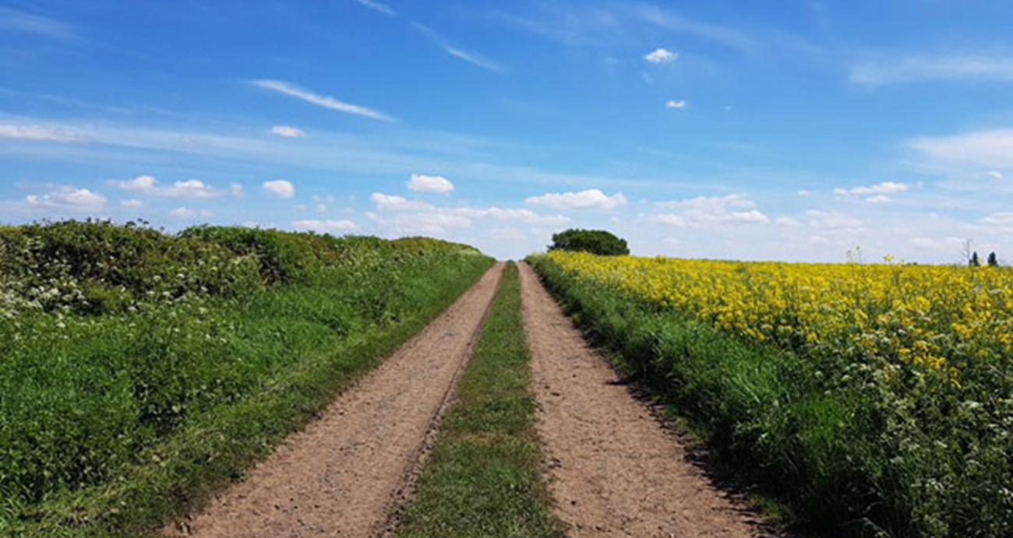
PLANNING PERMISSION
Provides certainty but hard process
Section 55 of the Town and Country Planning Act 1990
Burden of proof, especially in the countryside
Application requirements

Slide 7
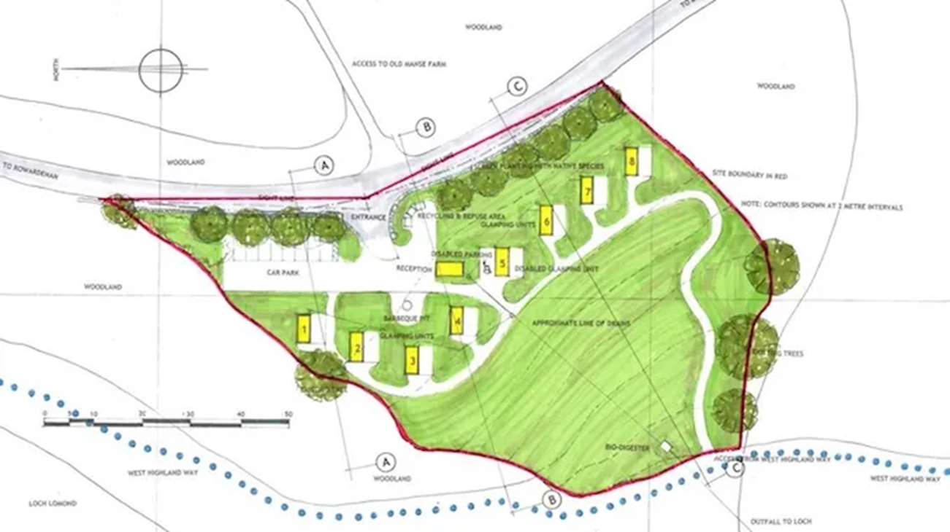
PLANNING PERMISSION

Slide 8
CARAVANS
Site specific
License
Application requirements

Slide 9
OTHER CONSIDERATIONS
Business Rates
Insurance
Health and Safety
Public Access

Slide 10
TYPICAL BUSINESS MODELS
High end, low volume glamping
Low volume, low maintenance caravan parking
Large-scale event-style temporary campsite
Long-term family campsite

Slide 11
STAGE 1: TEMPORARY SITE
Operate under 28-day rule
Minimal impact on main business and land use
Maximum occupancy from peak period
A testing and learning period

Slide 12
STAGE 2: LICENCING YOUR SITE
Unlocked licenced benefits
Invest in facilities
Extend your season
Increase your revenue

Slide 13
STAGE 3: ADDING GLAMPING
Increases revenue per land space
Increases length of stay
Increases your audience size
Investment backed by knowledge

Slide 14
Average nightly values (July 2022)
Tent camping £29.72
Motorhome/caravan £34.51
Glamping pod £99.50
Shepherd’s hut £113.47
Safari tent £159.00

Slide 15
STAGE 3: ADDING GLAMPING
Increases revenue per land space
Increases length of stay
Increases your audience size
Investment backed by knowledge

Slide 16
THINGS TO CONSIDER FIRST
Is there demand for your location?
Where, specifically, is the best site?
Do you have the time (and temperament)?

Slide 17
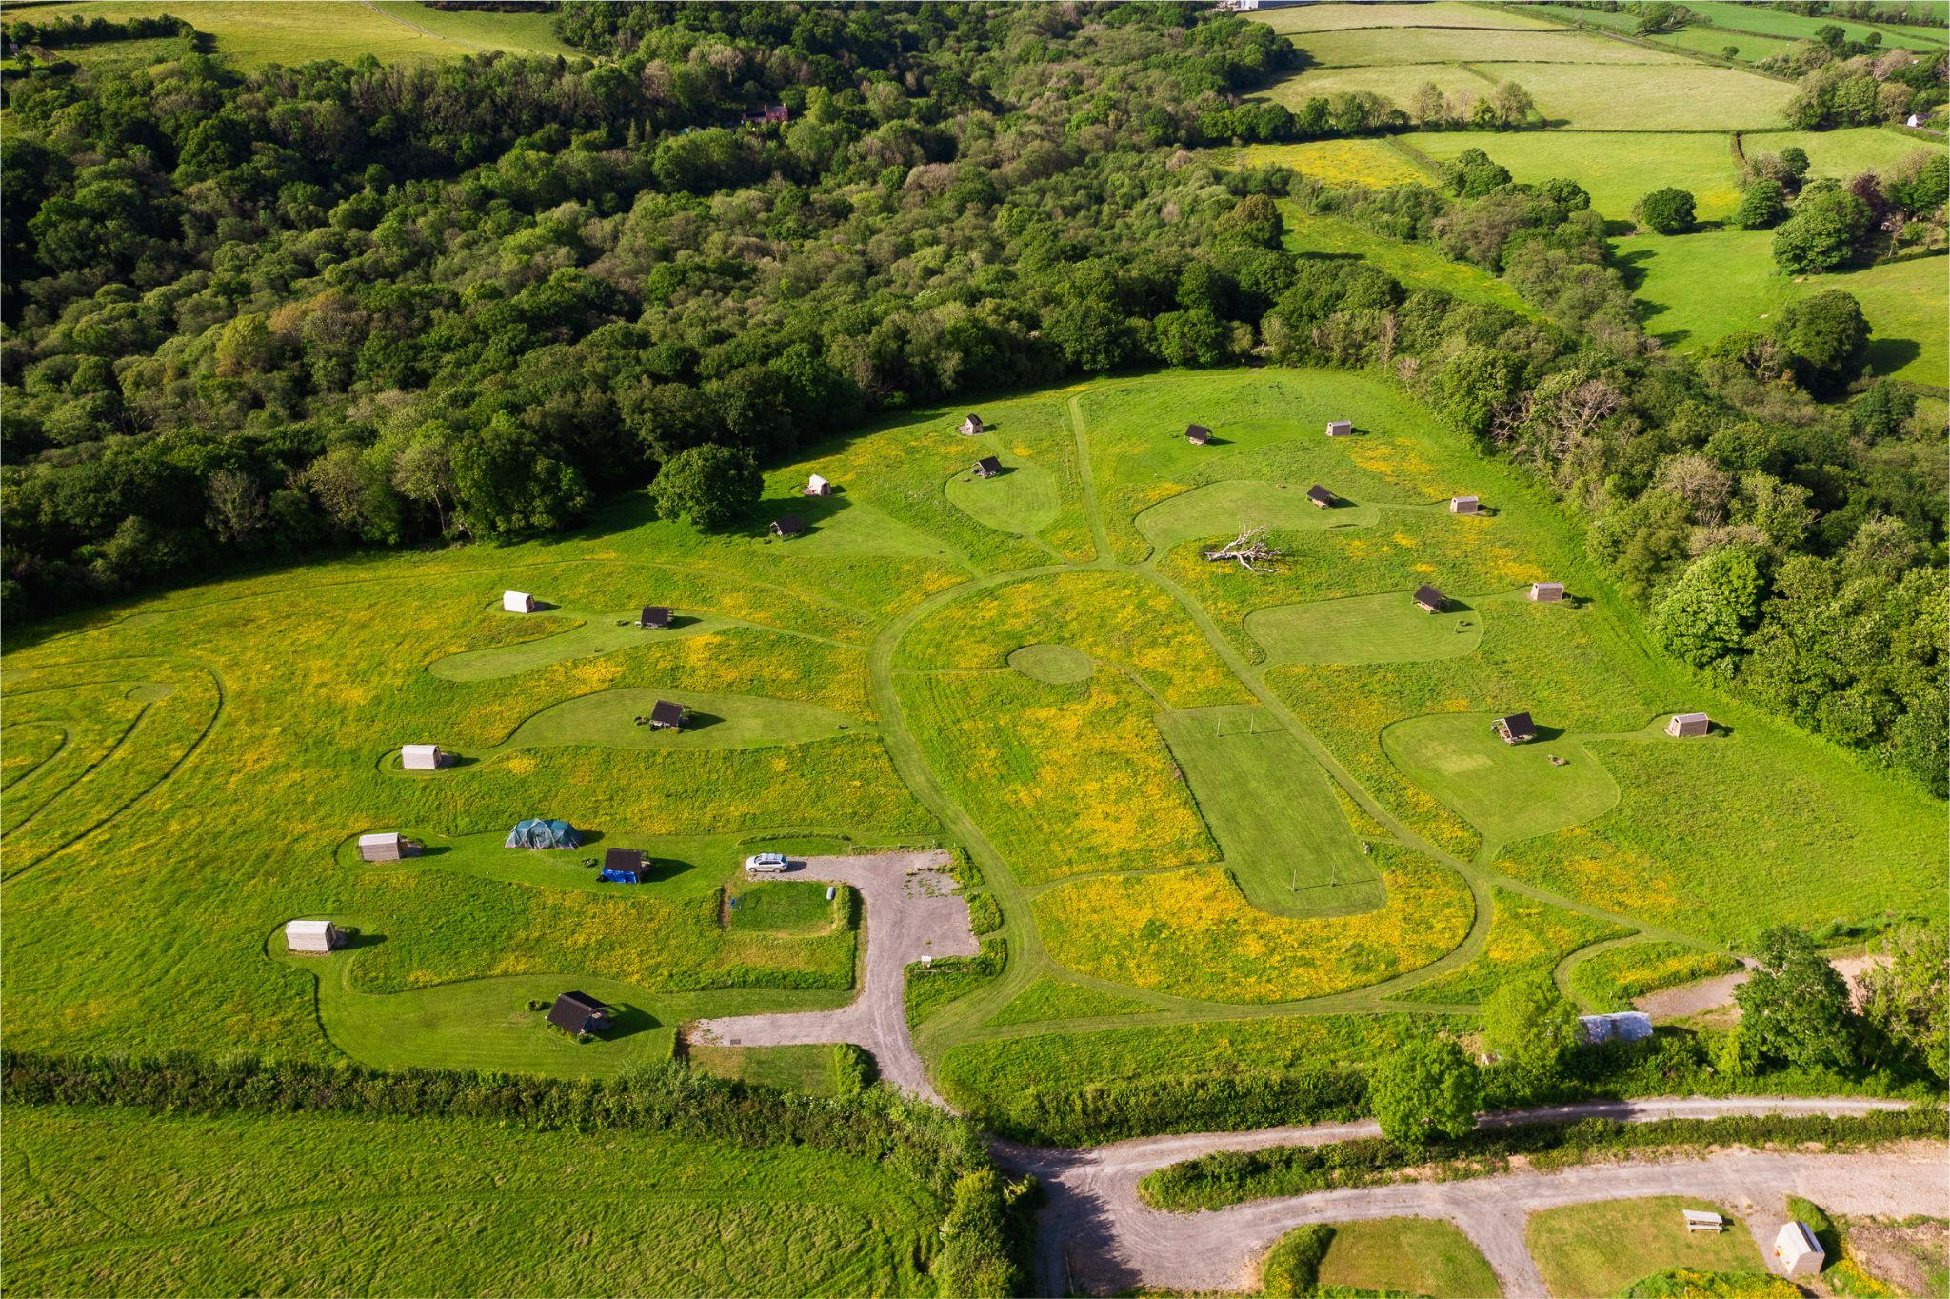
Notes:
Cowpots, Carmarthenshire
Individual toilet facilities
Ice-cream & pizza oven
Started as 1 meadow in 2018, now there are 3.
£55 for a family of 4 in summer.

Slide 18
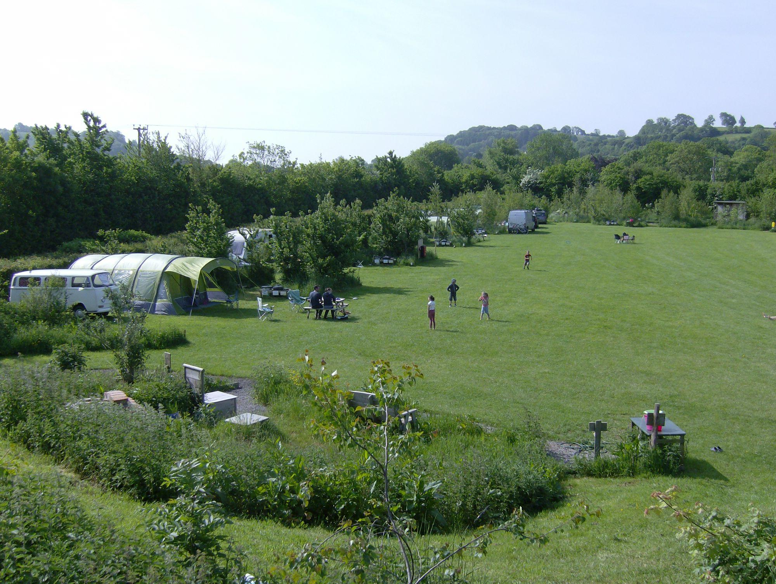
Notes:
Wookey Farm, Somerset. Near Cheddar Gorge.
Working goat farm.
Goats cheese, milk, and ice-cream.
Feed the pigs, collect eggs, watch goat milking time each day.
No showers. But electric.
Pitch and family of 4 = £30

Slide 19
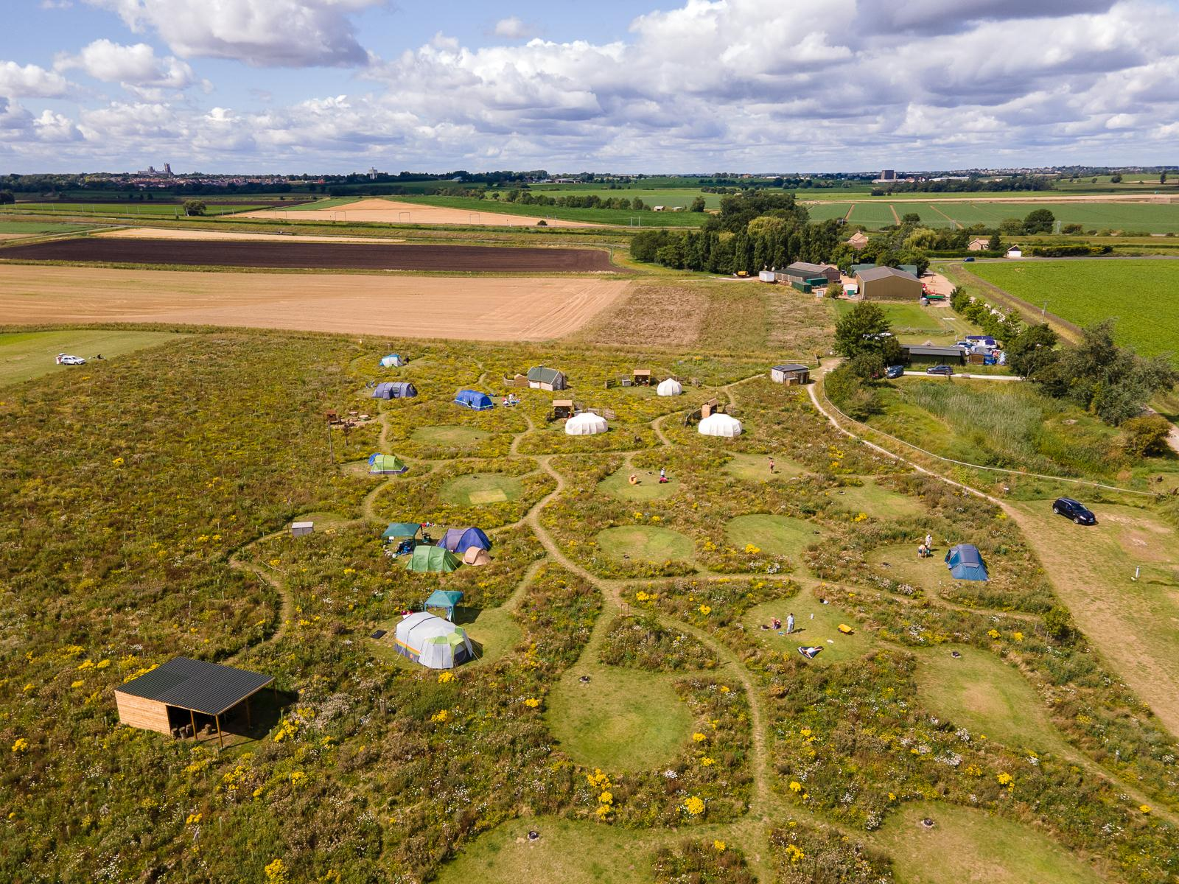
Notes:
Mad Hatters, Cambridgeshire
EU Agricultural Fund for Rural Development
LEADER Funding as a “project to develop a family orientated camping facility, including pitches for tents, caravans, and glamping”
Active member of Ely Nature Friendly Farming Zone
Family pitch = £26, Family glamping = £230–£270

Slide 20
FIND OUT MORE
‘How to start a campsite’ guide: hipca.mp/order-guide
Contact us: cla@hipcamp.com
Notes:
Sounds, smells.
Temperament – if you don’t want to deal with people, then consider how the hands-off experience can work? Automated check-in emails, contactless check-in etc. Keep it small scale.

Slide 21
Q&A SLIDE(S)

